Slide 1
Sudo//Build Hackathon
PS Domain : Smart City and Sustainability
Problem Statement Title: Aqua Insight : Empowering Water Sustainability through Smart Monitoring and Automation
Team Name: Stark Matrix
Team Leader Name: Sudharshan Vijay S K

Slide 2
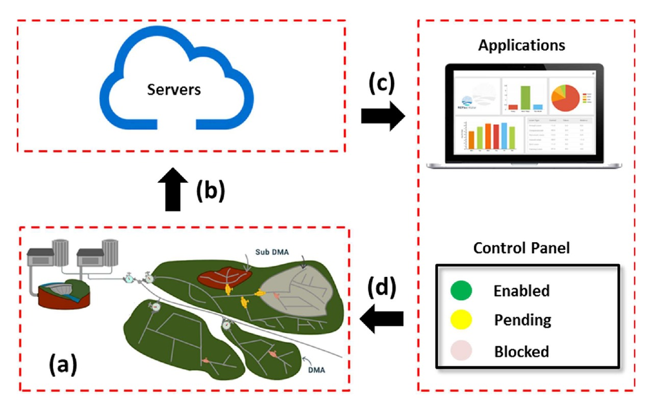
Idea/Approach Details
Idea / Solution:
AquaInsight is an advanced GIS tool for mapping, monitoring, and managing water supply.
It integrates IoT sensors, real-time monitoring, and user-friendly interfaces.
Key features include GIS-based mapping, real-time monitoring with strategically placed IoT sensors, and a user-friendly interface.
The system provides alerts for anomalies, role-specific notifications, and stores historical data for trend analysis.
AquaInsight aims to revolutionize water management, ensuring sustainability, efficiency, and community involvement.
Additionally, it develops an interactive map with layers for holistic viewing, a robust search function, and real-time monitoring through strategically deployed IoT sensors.
The tool ensures accessibility on web and mobile platforms, an intuitive interface with customizable views, and role-specific alerts.
It includes a communication hub for collaboration, emergency response, and a secure database for storing historical data.
An analytics dashboard supports trend analysis and informed decision-making.
Sample Workflow of AquaInsight
Describe your Technology stack here:
Django
Python
Firebase
ESP 32
Waterflow Monitoring Sensor, TDS, Turbidity Sensor
AWS

Slide 3
Idea Solution
The Problem
Unsafe Water: Contaminated water poses serious health risks in rural communities.
Inefficient Management: Massive water loss due to leaks and unfair distribution.
No Real-Time Data: Existing systems lack real-time insights for informed decisions.
Our Idea:
Aqua Insight A low-cost, IoT-based water management system.
Sensors: We use Water Flow, Turbidity, pH, and TDS sensors to get a complete picture of water usage and quality.
Function: The system sends real-time data to a central dashboard and provides instant alerts for any issues.

Slide 4
Real-World Impact & Our Vision
Better Health: By detecting contamination instantly, we protect communities from waterborne diseases.
Fair Distribution: Water corporations can use our flow data to ensure every household gets its fair share.
Saves Water & Money: The system helps to detect leaks and reduce wasted water, saving millions of liters and cutting costs.
Support for Everyone: Our on-call system provides support for users who are not familiar with technology, making our solution truly inclusive.
Our Vision
Pilot Program: Start with a small-scale pilot to validate the system.
Predictive Maintenance: Use data to predict future problems before they occur.
Scaling Up: Our goal is to work with government bodies to implement Aqua on a larger scale and build a healthier, more sustainable water future.

Slide 5
Idea/Approach Details
Use Cases here
Dependencies / Show stopper here
Water Quality Monitoring
Real-Time Monitoring for Leak Detection
Emergency Response Planning for water conservation and management.
Predictive Maintenance
Offers a user-friendly interface accessible to residents.
GIS tool visualizes the water supply network components.
Water Demand Planning.
Trend Analysis for Resource Allocation.
AquaInsight integrates a communication hub for stakeholders in decision making.
Dependencies :
Data Accuracy and Availability
Reliable IoT Sensor Deployment
Integration with existing water supply infrastructure and GIS databases is critical
Availability and reliability of technology infrastructure
Security and Privacy Compliance
Show stoppers :
Resistance to change or inadequate training may hinder user acceptance.
Issues in sensor deployment, such as technical malfunctions or insufficient coverage, could impede monitoring capabilities.
Advanced spatial analysis functionalities, such as overlays or geoprocessing, can add complexity to the GIS tool,

Slide 6
Thank You

